Slide 1
Characterising risk and biology Of Smouldering Myeloma for early detection Of Symptomatic myeloma: COSMOS, a prospective observational study in smouldering myeloma
Louise Ainley*, Elise Rees*, Sayeh Faroughi, Gwennan Ward, Grant Vallance, Kane Foster, Selina Chavda, Firas Al-Kaisi, Ceri Bygrave, Hannah Hunter, Jindrinska Lindsay, Agapi Parcharidou, Lydia Lee, Karthik Ramasamy, Kwee Yong
* Both authors contributed equally to this work

Slide 2
Disclosures
Takeda UK Ltd. (Speaker at meeting)

Slide 3
Background
Current SMM risk models allow us to estimate progression
Remains a need to characterise high risk SMM more accurately
SMM remains rare for each managing centre, need to coordinate care in the UK and identify interest group
Need for prospective follow up of patients and lack of prospective studies in SMM
COSMOS: observational prospective study running in England and Wales
Notes:
Current SMM risk models allow us to estimate progression
However these do not tell the whole story and low risk patients do progress and some high risk pateints remain stable
Therefore there remains a need to characterise high risk SMM more accurately
Particularly to identify patients who may benefit from treatment/ clinical trial entry in the future
SMM is a relatively rare condition for each hospital or clinic and we identified a need to coordinate care in the UK and identify an interest group
Particularly to plan for interventional studies in the future
Only UK based SMM clinical trial
COSMOS: observational prospective study running in England and Wales
I will present an outline of our study and some early results from our first year of recruitment

Slide 4
COSMOS Study Aims
To understand the genomic and immune correlates of progression from MGUS/SMM to MM, integrating with clinical parameters
To define clonal heterogeneity and biomarkers of progression using liquid biopsies (blood), and exploring the utility of serial samples.
To investigate T cell phenotype and functionality in SMM comparing stable with progressive disease.

Slide 5
Study set up
Progression
Baseline
12 months
24 months
36 months
48 months
Study end
Baseline:
BMAT, bloods,
Full clinical assessment
Previous imaging
During study:
Regular bloods including research
BMAT offered annually Imaging as clinically indicated
Progression:
BMAT, bloods, imaging
Full clinical assessment
Notes:
Inclusion criteria:
Any SMM patients – either new diagnosis or previously diagnosed, some MGUS
Who have no evidence of symptomatic myeloma damage or rapidly progressive markers suggestive of progression
SLiM CRAB patients can be included if being managed as SMM
We are Exploring utility of serial samples so patients have assessments at baseline and periodically over time and progression.
We will collect regular samples of blood, and follow up bone marrows to track changes over time, both in those that progress, and those that do not

Slide 6
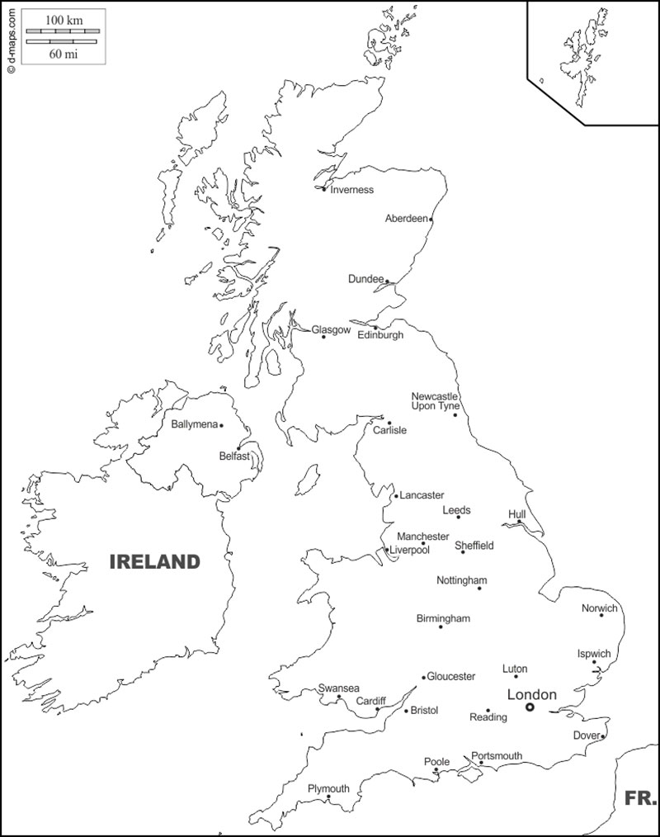
Currently 11 open study sites, 9 planned
Royal Derby Hospital 13 Participants Opened 25th January 2022
Nottingham University Hospital Opened 21st February 2022
Lincolnshire Clinical Research Facility Opened 6th June 2022
London: University College Hospital 54 Participants Opened 10th February 2021 Northwick Park Hospital 7 Participants Opened 6th December 2021 St George’s Hospital Opened 6th June 2022
East Kent Hospitals 9 Participants Opened 1st July 2021
Mid Yorkshire Hospital Opened 6th July 2022
Churchill Hospital, Oxford 5 Participants Opened 2nd December 2021
University Hospital of Wales, Cardiff 5 Participants Opened 19th July 2021
Derriford Hospital, Plymouth 2 Participants Opened 15th July 2021
Notes:
Number of sites: 11
Number of patients: 95 as of 1st August

Slide 7
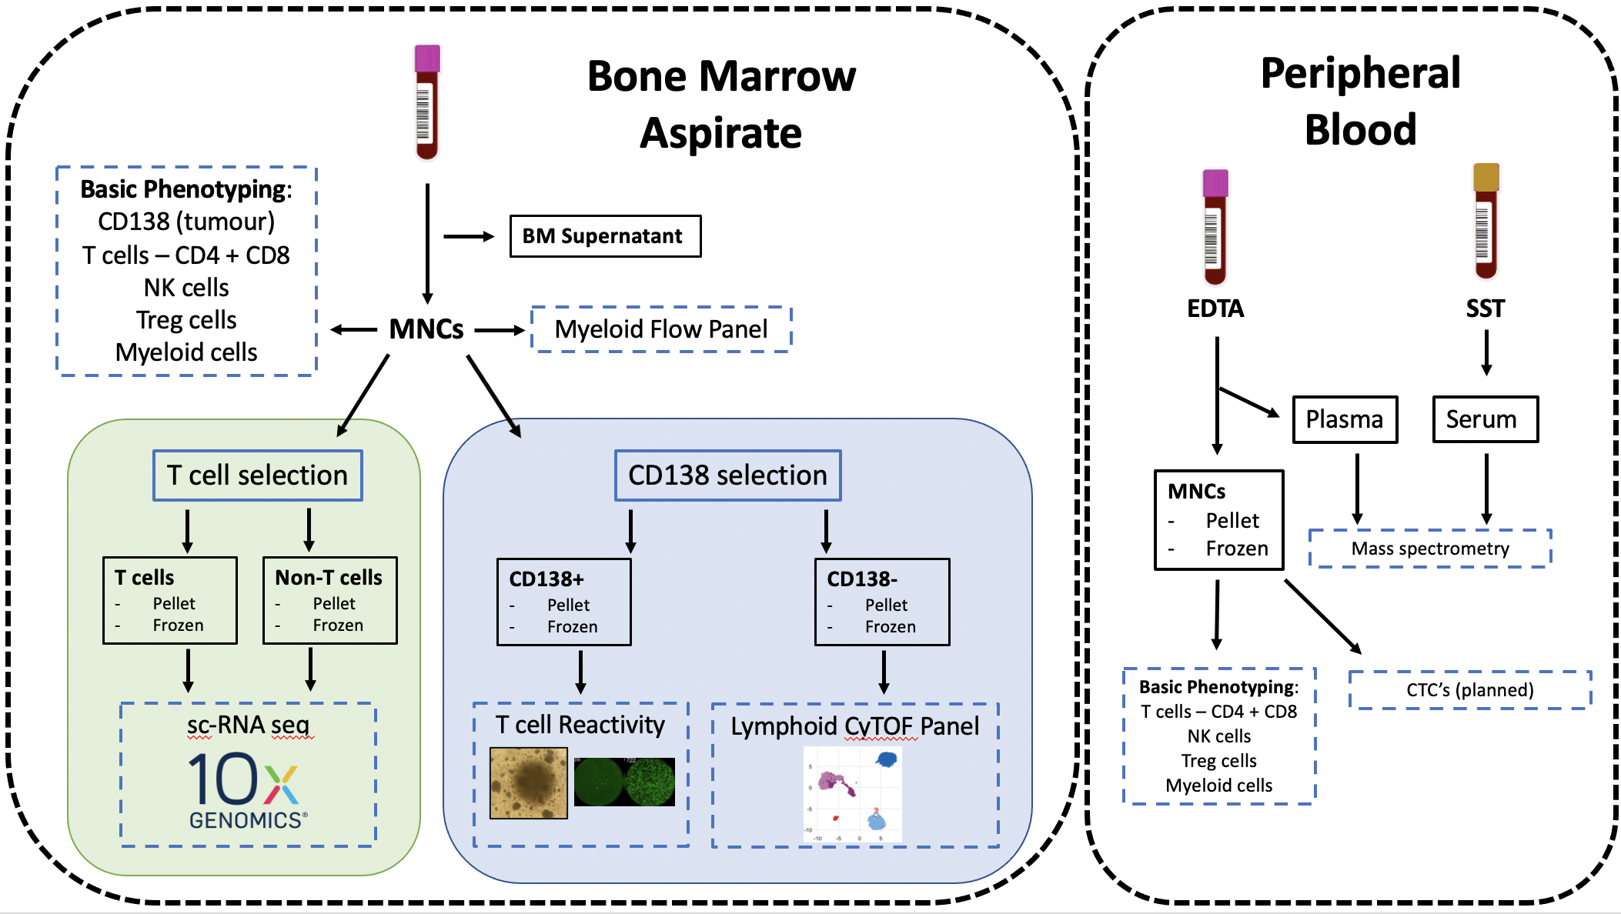
Laboratory workflow
T cell work presented by Kane Foster
Saturday 08:40AM West Hall B
Notes:
Our labarotory workflow is briefly outlined here:
We take marrow/ PB and isolate tumour and MNCs fresh
I will present our early results from our basic phenotyping panel that is performed fresh on each sample
We are also undertaking detailed immune phenotyping via a myeloid flow panel and lymphoid CyTOF panel
Focused T cell work will be presented by my colleague Kane Foster on Saturday
As patients progress/ over time we will correlate these with sequential PB samples

Slide 8
Patient Characteristics (total = 95)
Characteristic |  | Number (%)
Age range |  | 27-85 [median 67]
Sex- Male |  | 40 (55)
SMM MGUS |  | 62 (87) 9 (13)
Isotype
 | IgG | 50 (68)
 | IgA | 16 (22)
 | Light chain | 6 (8)
 | IgM | 1 (1)
Kappa |  | 41 (56)
Newly diagnosed |  | 18 (26)
Months since diagnosis |  | 0-176 [median 20]
Off study |  | 9 (12)
High risk features |  | Number (%)
Median paraprotein at entry |  | 17g/L [range 1-40]
Median SFLC ratio at entry |  | 7.1 [range 1.1- 455]
Median bone marrow PC at entry |  | 15% [range 5-50]
Immunoparesis at entry* |  | 51 (72)
High risk CGN at entry** |  | 20 (36)
 | +1q | 14 (27)
 | t(4;14) | 3 (6)
 | del17p | 1 (2)
 | t(14;16) | 1 (2)
Mayo 202020 at diagnosis
 | low | 19 (37)
 | int | 20 (39)
 | high | 12 (25)
*Defined as one uninvolved Ig < normal range
**Defined as per IMWG 2020:
t(4;14), t(14;16), 1q gain, del13q
Not all data available for all patients
Notes:
Reasons for off study include progression (7), withdrew (2)

Slide 9
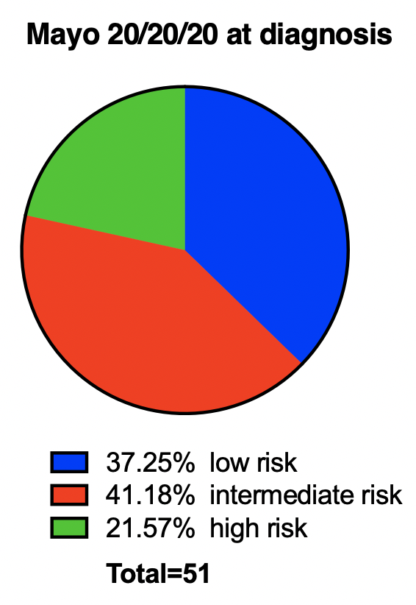
Our SMM patients had an expected distribution across risk scores with variation across different scoring systems
Risk score | Mayo 20/20/20 | IMWG (including CGN) | IMWG individualised
Low risk | 19 (37%) | 7 (19%) | 18 (42%)
Low- int risk |  | 15 (42%) | 16 (37%)
Int risk | 21 (41%) | 10 (28%) | 6 (14%)
High risk | 11 (22%) | 4 (11%) | 3 (7%)
Notes:
Our SMM patients had an expected distribution of patients across risk scores with heterogeneity across different scoring systems
Pie chart on the right shows Mayo 202020 score at diagnosis (not available for all patients)
The table on the left shows variation in proporiation of patients that are high risk across the different scoring systems, in line with other published cohorts
Our patients are representative: they do not significantly differ in risk profiles compared to published data
IMWG 2020 paper:
Mayo 202020
Low 38%
Int 33%
High 29%
Score with CGN
Low 33%
Low int 33%
Int 26%
High 9%
Individualised risk score
Low 35%
Low-int 38%
Int 19%
High 7%

Slide 10
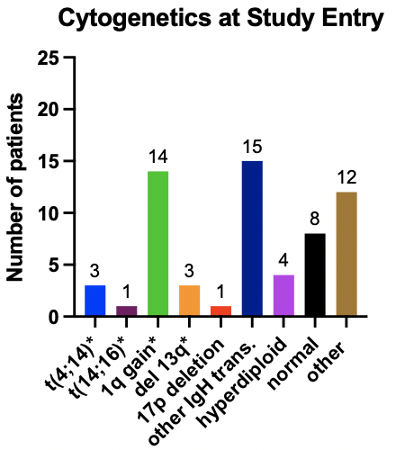
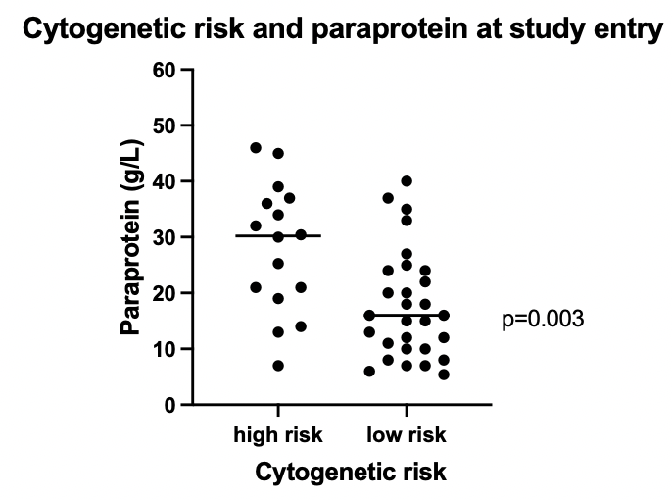
Cytogenetic risk correlated with paraprotein level at study entry
1q gain, t(11;14) and normal were the commonest FISH results
* high risk CGN abnormalities
Notes:
*other includes: gain TP53, hypodiploidy, monosomy 13, loss 16q, loss 1p, IgH loss

Slide 11
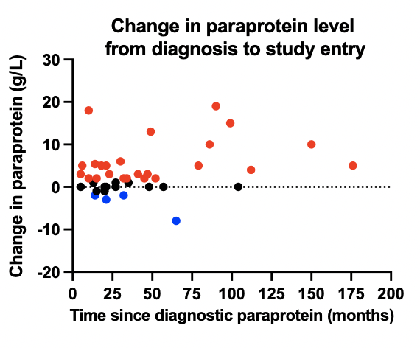
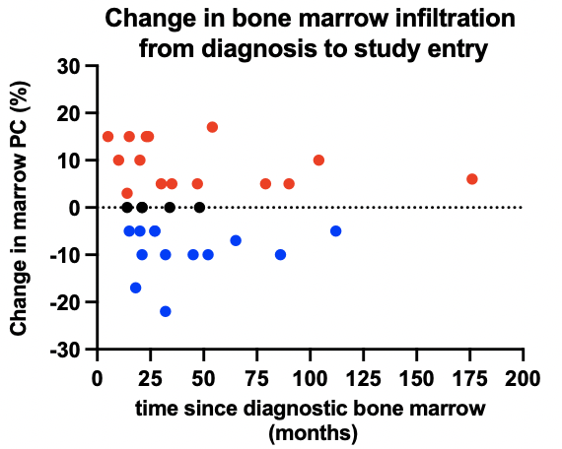
Variations in marrow infiltration on follow up sampling
Notes:
Of patients who had reduced BM PC% at entry compared to diagnosis:
1 went from 40% to 15% on trephine, 23% on aspirate but had rising SFLC
1 went from 30% trephine to 8% with no change in other parameters
Reduction likely due to:
Quality of samples
Reporting variation (trephine vs aspirate)
Spatial heterogeneity of myeloma
Compared to paraprotein on the right where most patients have an increasing level- this may reflect a more complete assessment of disease burden than marrow

Slide 12
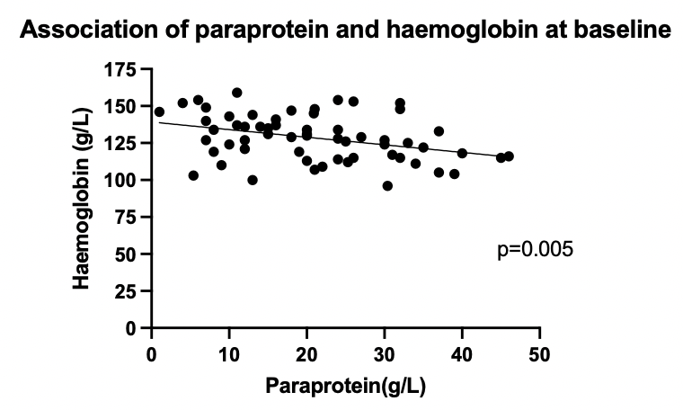
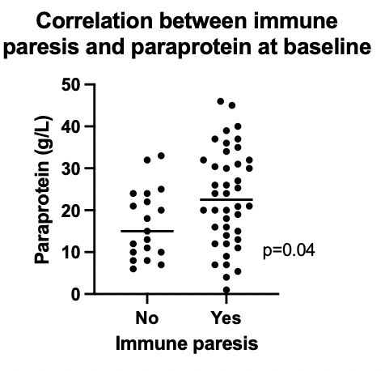
On correlative analysis haemoglobin level and presence of immune paresis were significantly associated with paraprotein level
Notes:
There was a trend to reduction in haemoglobin and increased bone marrow infiltration (non significant)
No correlations with creatinine, calcium and disease markers

Slide 13
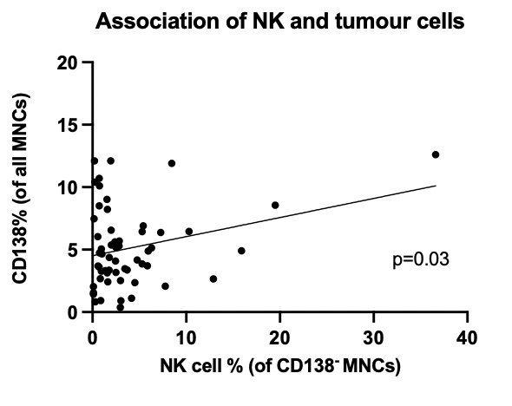
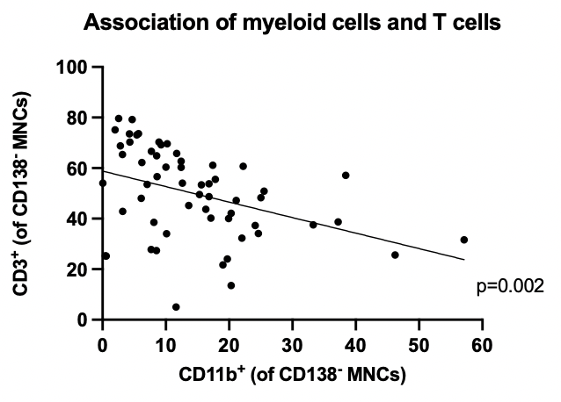
Analysis of immune populations did not show correlations with clinical data including risk scores
BM NK cells positively correlated with tumour (CD138⁺) BM myeloid cells negatively correlated with T cells
Notes:
Analysis of immune populations did not show correlations between immune population with clinical data including risk scores
We did identify that NK cells positiviely correlated with tumour (CD138+) in our cohort
Myeloid cells negatively correlated with T cells in this cohort

Slide 14
Conclusions
COSMOS is a prospective observational study exploring serial sampling in precursor patients
Establishing UK interest and planning for interventional studies for our high-risk patients
We have shown good uptake in clinical trials in UK SMM patients and recruited a representative population based on other published data
Early results of basic immunophenotyping illustrate heterogeneity of this condition and the need for more detailed longitudinal analysis

Slide 15
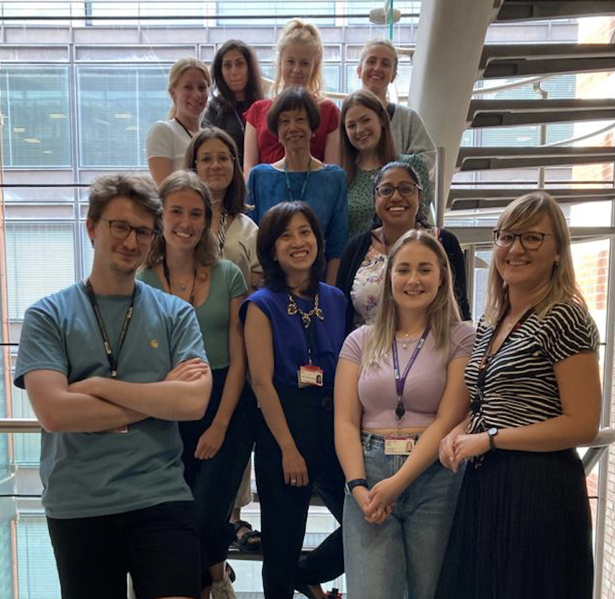
Acknowledgements
COSMOS team
Prof Kwee Yong Dr Lydia Lee
Dr Karthik Ramasamy Dr Elise Rees
Sayeh Foroughi Kane Foster Gwennan Ward
UCL myeloma lab
Selina Chavda Anna Mikolajczak
Emma Lyon Daria Galas-Filipowicz
COSMOS sites and PIs
Dr Ceri Bygrave
Dr Jindrinska Lindsay
Dr Firas Al-Kaisi
Dr Hannah Hunter
Dr Agapi Parcharidou
All patients and their families

